Slide 1
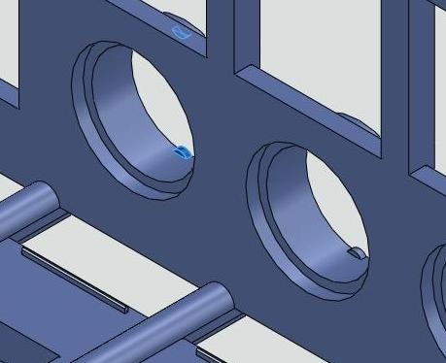
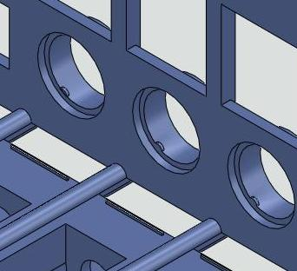
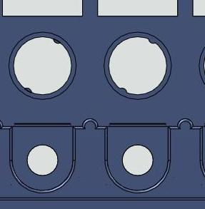
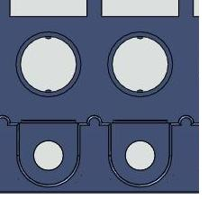
Existing body part
Correction to be done on body part
Correction of projection
on body (to be done in rubber mould)
Position of the projection should be vertical & in the rear side as shown in the picture above
Existing position of
projection on body

